Slide 1







Slide 2
Domestic Violence Awareness & VAWA Requirements
Stacey Riley, LCSW
Chief Executive Officer
Gulf Coast Center for Nonviolence

Slide 3
Gulf Coast Center for Nonviolence
Mission Statement:
GCCFN is committed to fostering a secure, nurturing, and empowering atmosphere for individuals and families impacted by interpersonal violence and trauma. We deliver holistic, compassionate, and coordinated trauma-informed services that facilitate healing, advocate for justice, and build resilience within our community.

Slide 4
Services Provided
Emergency Shelter Services at Two Locations
Counseling (individual & group)
Case Management
Court Advocacy Services
Civil legal services
Children's Program, including a Therapeutic Pre-School
Housing Programs
Support for survivors of sex trafficking
Forensics Medical Clinic
Outreach and Awareness
Batterer’s Program (Domestic Violence Intervention Program)
Services to family members and loved ones of homicide victims
Volunteer Program

Slide 5

What is Domestic Violence?
Any incident or pattern of incidents of controlling, coercive or threatening behavior, violence or abuse between those who are or have been intimate partners or family members regardless of gender or sexuality. Domestic abuse isn’t just about violence; it can involve many different types of behavior such as:
Coercive control
Physical abuse
Sexual abuse
Financial abuse
Emotional abuse

Slide 6
01. Coercive Control
The Foundation of Abuse

Slide 7
Coercive Control
A pattern of behavior of behavior which seeks to take away the victim’s liberty or freedom and to strip away their sense of self

Slide 8
How Do Abusers Gain Power And Control?
Romance
Love Turns Abusive
Dependence
Whirlwind, fairy tale
Love-bombing
Gain trust and confidence
Safe space to confess secrets, shame, and fears
Jealousy and possession
Laying foundation for sets of rules
Critical of what “makes you, you.”
Merging finances
Isolation from friends and family
Surveillance

Slide 9

Tools to Maintain
Power and Control
Coercion and Threats
Emotional Abuse
Intimidation
Isolation
Minimizing, Denying, Blaming
Using Children
Economic Abuse
Male Privilege

Slide 10

Abusers don’t use violence because they have lost control of themselves.

Slide 11
Abusers use violence when they’ve lost control of their partner.

Slide 12
02. Trapped in Abuse
How Abusers Make it Difficult to Leave

Slide 13

Forged Dependence
Financial abuse leaves the victim without access to money.
Isolation keeps the victim from family and friends.
Children being used as leverage keeps the victim from leaving.
Constant surveillance leaves the victim unable to reach out for help.

Slide 14

Romance & Love Still Plays a Role
The victim wants the relationship to work.
There are good times.
There are moments of reminiscing on “the good days.”
After the abuser causes trauma, instead of taking accountability for causing the trauma, the abuser will frame it as a hardship they have overcome as a couple

Slide 15
03. The Danger Zone
Signs that an Abusive Relationship Could Turn Fatal

Slide 16
Signs That a Relationship Could Be Fatal
Abuser has used or threatened to use a weapon again victim.
Abuser has threatened to kill victim or victim's children.
Abuser has attempted to strangle or has strangled the victim in the past.

Slide 17
Signs That a Relationship Could Be Fatal
Strangulation – pressure on the neck by any means. Increases homicide risk by 700%
Gun ownership – If there is a gun in the home, the homicide risk increases by 500%

Slide 18

Leaving is a Process, Not an Event
It’s different for everyone
Leaving is dangerous
Only the victim can make that decision
Takes considerable community support, empathy, and patience from friends and family
A victim will not leave until ready to leave
It’s painful to learn that sometimes love requires boundaries.

Slide 19

First Steps to Freedom
Fighting Isolation
Safety Planning
Connecting with Victim Services

Slide 20
04. VAWA Protections
How We Can Help Protect Victims

Slide 21
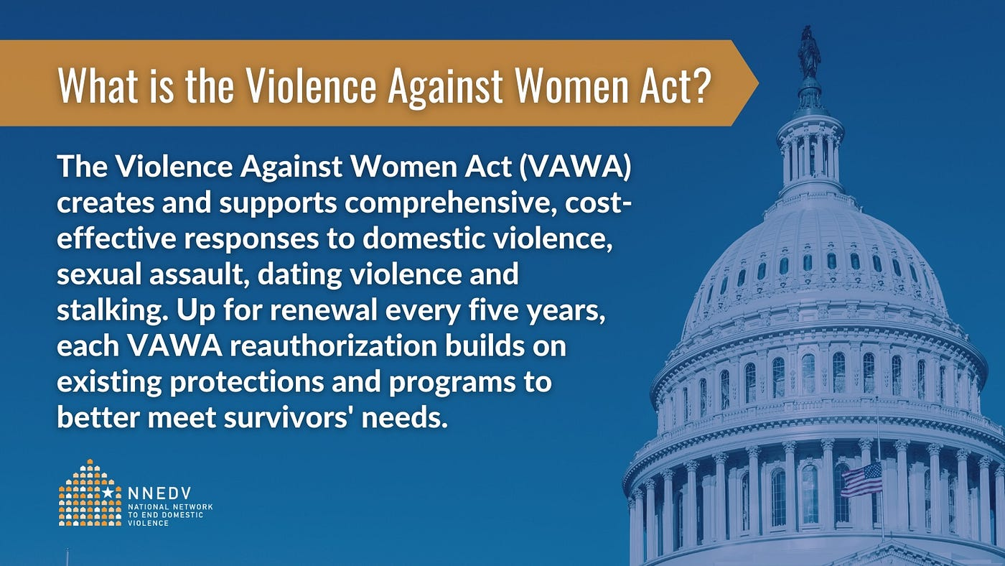

Slide 22
Key Housing Protections Under VAWA
Must be Allowed to Self-Certify: can’t require “proof” of victimization
Protection from Eviction: Landlords cannot evict tenants just because they are victims of domestic violence.
Emergency Transfers: Victims can request a transfer to another safe housing unit. They must have an option to stay in current housing.
Confidentiality: Landlords cannot disclose a victim’s information.
Lease Bifurcation: The abuser can be removed from the lease without affecting the victim’s housing.
Right to Seek Law Enforcement Assistance without penalty.

Slide 23

Who is Covered?
VAWA housing protections apply to:
Public housing
Section 8 housing choice vouchers
Project-based rental assistance
Specialized Housing Programs – ESG, CoC, HOPWA, HOME, Housing Trust Fund
USDA rural housing programs
VAWA does NOT cover:
Private landlords without federal funding

Slide 24
How Landlords Can Assist Victims
Provide all tenants with Notice of Rights (HUD 5380)
Assure confidentiality
Assist victims with self certification process (HUD 5382)
Always follow your Emergency Transfer Plan
Work with victim to make lease modification (removal of abuser and early lease termination)
Train staff on VAWA protections
Connect Tenants with support services

Slide 25
QUESTIONS

Slide 26
Contact Information
Stacey Riley, CEO
Gulf Coast Center for Nonviolence
213 Porter Ave.
Biloxi, MS 39532
228-207-4952
sriley@gccfn.org

